Slide 1
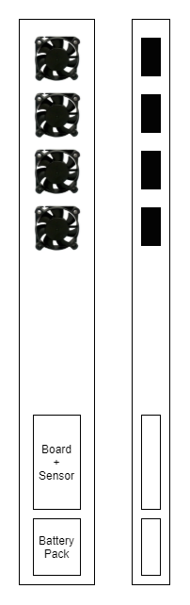
- 2 way Spin DC Fan (Refer to next slide)

Slide 2
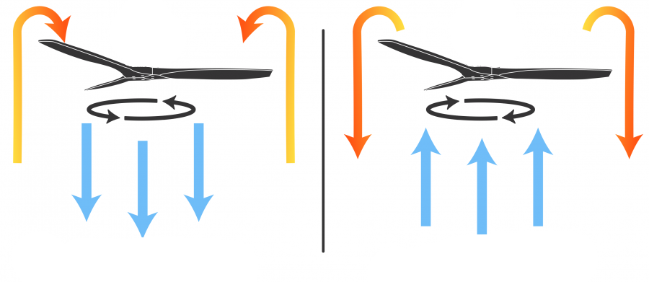

Slide 3
Mobile App
On/Off
On/Off LED Light
Settings
Maintenance reminder
Sensor reading (CO, CO2)

